Slide 1
Securing understanding of equality
Solving linear equations

Slide 2
how to use Oak lessons

Slide 3
I can appreciate how to maintain equality between two statements.

Slide 4
An equation is used to show two expressions that are equal to each other.
A variable is a quantity that can take on a range of values, often denoted by a letter.
A constant is a term that does not change; it contains no variables.
Like terms are terms that have the same set of variables and corresponding exponents.

Slide 5

Securing understanding of equality
Maintaining equality in bar models
Maintaining equality in equations

Slide 6
Maintaining equality in bar models
Bar models can be used to represent expressions with variable terms, constant terms or both.
x
x
x
x
5
y
1
7
8
4x + 5
y + 1
7 + 8
2
2
2
2
2
a
b
a
b
2 + 2 + 2 + 2 + 2
a + b + a + b ≡ 2a + 2b
When the bars are equal length, we can write an equation.
x
x
x
x
5
4x + 5 = 10 + 8
10
8

Slide 7
Maintaining equality in bar models
The bar model below shows the expressions 8 + 2 and 7 + 3
8
2
These are equal (both expressions equal 10) so we can write 8 + 2 = 7 + 3
7
3
Because expressions on both sides of an equals sign are equal, we could also write this as 7 + 3 = 8 + 2
We can refer to the expressions as the left and right hand side:
8 + 2 = 7 + 3
left hand side (LHS): the whole expression left of the equals sign
right hand side (RHS): the expression right of the equals sign

Slide 8
Maintaining equality in bar models
8
2
1
8 + 2 = 7 + 3
7
3
1
=
8 + 2 + 1 7 + 3
≠
If I add 1 to the left hand side of this equation, what happens to my values?
8 + 2 + 1 = 11
This is no longer an equation as I haven’t maintained the equality of both sides of the original equation.
8 + 2 + 1 = 7 + 3 + 1
What have I done differently this time? Have I maintained equality?
Yes, both sides have remained equal. One has been added to both sides of the equation.

Slide 9
Maintaining equality in bar models
To maintain equality, if a value is added to one side of an equation, it must also be added to the other side of the equation.
How can we write an equation for this bar model?
a
5
a
a + 5 = 17
17
a
How can we maintain equality in this bar model now?
Add a to the other bar as well
What would the equation look like now?
a + 5 + a = 17 + a
or
2a + 5 = a + 17

Slide 10
Maintaining equality in bar models
Would these operations maintain equality?
a
5
c
a + 5 = 17
17
3
a + 5 + c = 17 + 3
No, different values are added to each side. c is a variable term so it is not always equal to 3
Would these operations maintain equality?
a
5
b
5
a + 5 = 17
17
b
5
a + 5 + b + 5 = 17 + b + 5
Yes, the same values have been added to both sides of the equation.

Slide 11
Maintaining equality in bar models
Would these operations maintain equality?
a
5
6
a + 5 = 17
17
−6
a + 5 + 6 = 17 + (−6)
No, different values are being added.
The bar model is misleading here. Adding −6 is the same as subtracting 6
a
5
6
The length of the bars shown by the arrows are no longer the same. A different value was added to each bar.
6
17

Slide 12

Maintaining equality in bar models
Complete the bar models to maintain equality.
x
3
3
x + 3 = 10
a
10
3
x + 3 + 3 = 10
+ 3
x + 3 = 10
b
x
3
y
x + 3 = 10 + y
10
y
+ y
x
x
3
x + 3 = 10
c
10
x
x + x + 3 = 10
+ x

Slide 13
Maintaining equality in bar models
Here we have the equation we looked at earlier 8 + 2 = 7 + 3
8
2
8
2
7
3
7
3
What operation have I done to the top bar?
Added (8 + 2)
Doubled the length of the bar
What could I do to maintain equality?
Add (8 + 2) to the bottom bar
Double the bottom bar, this is the same as adding (7 + 3)

Slide 14
Maintaining equality in bar models
If we doubled the top and bottom bars, how could we write that as an equation?
8
2
8
2
8 + 2 = 7 + 3
7
3
7
3
2(8 + 2) = 2(7 + 3)
We need to use brackets here, as the whole expression has been multiplied by 2
The convention is to write the multiplier in front of the brackets.
2(8 + 2) = 2(7 + 3)
2(10) = 2(10)
Both sides of the equation equal 20 so we have maintained equality.

Slide 15
Maintaining equality in bar models
What happens if we only double one term in the expression?
8
2
8
8 + 2 = 7 + 3
2(8) + 2 =
7
3
2(7) + 3
2(8) + 2 = 2(7 + 3)
Can we maintain equality by doubling one term on the other side?
No, the left hand side is now equal to 18 and the right hand side equals 17
Can we maintain equality by doubling the entire expression on the other side?
No, when multiplying an expression, we need to multiply the whole expression on each side of the equals sign.

Slide 16
Maintaining equality in bar models
This is the same for expressions with variable terms.
p
p
2
p
p
2
p
p
2
2p + 2 = q + 7
q
7
q
7
q
7
3(q + 7)
3(2p + 2) =
What operation have we done to the top bar?
Multiplied by 3
What do we need to do to the bottom bar?
Multiply by 3
If we group like terms in our bar model, we can see every term has been multiplied by 3
p
p
p
p
p
p
2
2
2
6p + 6 = 3q + 21
q
q
q
7
7
7

Slide 17
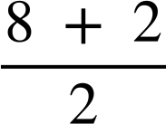
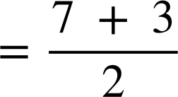

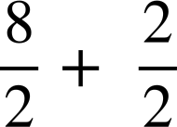
Maintaining equality in bar models
We can do the same for division.
8 + 2 = 7 + 3
We need to divide the whole expression by 2. This is the same as dividing each term by 2
=
= 5
= 4 + 1
= 5
Make sure we also divide the whole of the right hand side by 2

Slide 18


Maintaining equality in bar models
This is the same for expressions with variable terms.
p
p = 12
12
=
To maintain equality we need to divide the bottom bar by 3 as well.

Slide 19
Maintaining equality in bar models
Match the bar models to the equations.
a
x
x
3
x
x
3
2x + 3 + x + 3 = 17 + x + 3
17
17
x
x
3
x
x
3
2(2x + 3) = 2(17)
b
17
x
x
3
c
x
x
3
x
3
2x + 3 + 2x + 3 = 17 + 2x + 3
17
x
3
x
x
3
x
x
3
x
x
3
3(2x + 3) = 3(17)
d
17
17
17

Slide 20
Maintaining equality in bar models
Complete each bar model so it maintains equality, given that 2a + 3 = b + 8
a)
a
a
3
5
d)
a
a
3
b
8
b
b
8
b)
a
a
3
e)
a
a
a
a
3
3
b
8
a
b
8
c)
a
a
3
a
a
3
a
a
3
b
8

Slide 21
Maintaining equality in bar models
2) The bar models are not drawn to scale. Given that 2c + 18 = 3x + 21
Which bar models will maintain equality, and should be the same length?
Explain your reasoning.
a)
c
c
18
18
d)
c
c
c
c
18
x
x
x
21
x
x
x
x
x
x
x
x
21
b)
c
c
18
c
c
e)
c
c
c
c
18
18
x
x
x
21
c
c
x
x
x
x
x
x
21
21
c)
c
c
c
c
18
18
f)
c
c
x
18
x
x
x
21
c
c
18
x
x
x
x
21

Slide 22
Maintaining equality in bar models
Complete each bar model so it maintains equality, given that 2a + 3 = b + 8
a)
a
a
3
5
d)
a
a
3
b
b
8
5
b
b
8
e) e.g.
b)
a
a
3
a
a
a
a
a
3
3
b
8
a
b
8
b
8
c)
a
a
3
a
a
3
a
a
3
b
8
b
8
b
8
or
a
a
3
a
a
3
a
a
3
b
8
a
a
3
a
a
3

Slide 23
Maintaining equality in bar models
2) The bar models are not drawn to scale. Given that 2c + 18 = 3x + 21
Which bar models will maintain equality, and should be the same length?
Explain your reasoning.
a)
c
c
18
18
No, 18 is added to the top but 2x added to the bottom.
x
x
x
21
x
x
b)
c
c
18
c
c
Yes, 2c added to both. These should be equal.
x
x
x
21
c
c
c)
c
c
c
c
18
18
Yes, 2c + 18 added to both. These should be equal.
x
x
x
21
c
c
18

Slide 24
Maintaining equality in bar models
2) The bar models are not drawn to scale. Given that 2c + 18 = 3x + 21
Which bar models will maintain equality, and should be the same length?
Explain your reasoning.
No, 2c added to the top and 3x added to bottom. The whole expression hasn’t been doubled.
d)
c
c
c
c
18
x
x
x
x
x
x
21
e)
c
c
c
c
18
18
Yes, both expressions have been doubled. These should be equal.
x
x
x
x
x
x
21
21
Yes, x has been added to both. These should be equal.
f)
c
c
x
18
x
x
x
x
21

Slide 25
Securing understanding of equality
Maintaining equality in bar models
Maintaining equality in equations

Slide 26
Maintaining equality in equations
We have seen that expressions on both sides of an equals sign have the same value.
With a bar model, we can add the same value to both bars to maintain equality.
We can do the same with any equation.

Slide 27
Maintaining equality in equations
Alex is a years old, Sam is b years old.
How old will they be in 5 years time?
Alex: a + 5
Sam: b + 5
If Alex and Sam are the same age now, will they be the same age in 5 years time?
Were they the same age 5 years ago?
Yes. If a = b then
a + 5 = b + 5 and
a − 5 = b − 5

Slide 28
Maintaining equality in equations
In general if a = b
then a + c = b + c
Here is an equation:
2x − 7 | = | y + 3
2x − 7 + 5 | = | y + 3 + 5
2x − 2 | = | y + 8
2x − 2 + 5.2 | = | y + 8 + 5.2
2x + 3.2 | = | y + 13.2
2x − 7 | = | y + 3
2x − 7 + 5 | = | y + 3 + 5
2x − 2 | = | y + 8
2x − 2 + 5.2 | = | y + 8 + 5.2
2x − 7 | = | y + 3
2x − 7 + 5 | = | y + 3 + 5
2x − 2 | = | y + 8
2x − 7 | = | y + 3
2x − 7 + 5 | = | y + 3 + 5
2x − 7 | = | y + 3
We can add 5 to both sides of the equation and equality is maintained.
As long as we add the same value to the expressions on both sides of the equation, the expressions will remain equal to each other.

Slide 29
Maintaining equality in equations
This is true for any value we wish to add including negative values and variables.
How would I maintain equality this time?
2x − 7 | = | y + 3
2x − 7 + (−5) | = | y + 3
2x − 12 | = | y − 2
2x − 7 | = | y + 3
2x − 7 + (−5) | = | y + 3
+ (−5)
How would I maintain equality this time?
2x − 7 | = | y + 3
2x − 7 ..……. | = | y + 3 + y − 2
2x + y − 9 | = | 2y + 1
2x − 7 | = | y + 3
2x − 7 ..……. | = | y + 3 + y − 2
+ y − 2

Slide 30
Maintaining equality in equations
Fill in the blanks to maintain equality.
a | = | b
a + 5 | = | b ____
a | = | b
a______ | = | b + a + 3
a
c
a | = | b
a − 2 | = | b ____
d
a | = | b
________ | = | 2b − 6
b

Slide 31
Maintaining equality in equations
Fill in the blanks to maintain equality.
a | = | b
a + 5 | = | b + 5
a | = | b
a + a + 3 | = | b + a + 3
a
c
a | = | b
a − 2 | = | b − 2
d
a | = | b
a + b − 6 | = | 2b − 6
b

Slide 32
Maintaining equality in equations
We can multiply both sides of an equation by the same value to maintain equality.
In general if a = b then
ac = bc
5(2x − 7) | = | 5(y + 3)
Remember the whole expression needs to be multiplied.
2x − 7 | = | y + 3
10x − 35 | = | 5y + 15
We can expand the brackets to give an expression without brackets if desired.

Slide 33
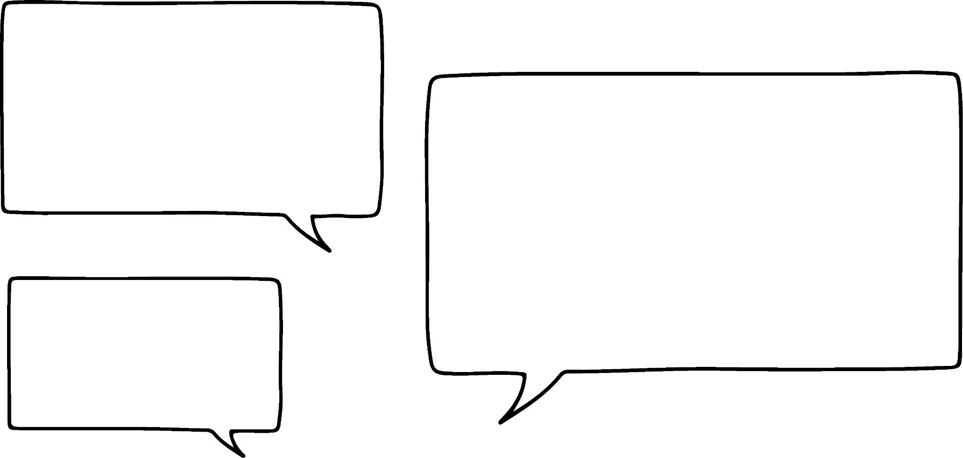

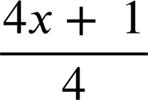
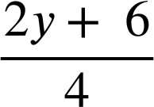
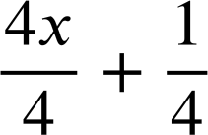
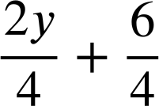
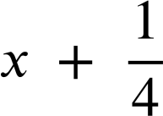
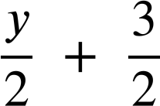
Maintaining equality in equations
I have written this equation. Can I divide it all by the same value and maintain equality?
4x + 1 | = | 2y + 6
=
=
Sam
=
Let’s try dividing this equation by 4
Remember the whole expression needs to be divided by 4
If we want, we can divide the individual terms by 4

Slide 34
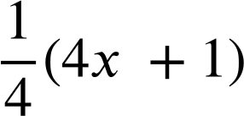
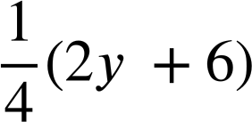
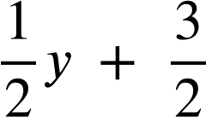
Maintaining equality in equations
Isn’t dividing by 4 the same as multiplying by a quarter? Does this give the same answer?
4x + 1 | = | 2y + 6
=
=
Sam
We can expand the brackets if we wish.
This gives us the same expressions as before; Sam is correct.
Different ways of writing expressions can be useful at different times. Generally, fractions are easier to work with than decimals.

Slide 35

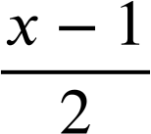
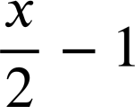
Maintaining equality in equations
Which of these maintain equality?
a
x − 1 | = | 6
7(x − 1) | = | 7(6)
d
x − 1 | = | 6
9x − 9 | = | 54
x − 1 | = | 6
(x − 1) | = | 4
x − 1 | = | 6
 | = | 3
b
One quarter of 6 is not 4
e
The entire LHS has not been multiplied by 3
The entire LHS has not been divided by 2
x − 1 | = | 6
3x − 1 | = | 18
x − 1 | = | 6
 | = | 3
c
f

Slide 36
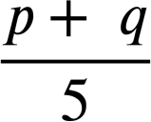
Maintaining equality in equations
Fill in the blanks in these equations so they maintain equality.
a | = | b
a + 8 | = | b______
a − 2 | = | b______
g)
a)
d)
3x + 4 | = | y + 1
3x + 4 − x | = | y + 1______
p + q | = | 10
 | = | ______
e)
3x + 4 | = | y + 1
________ | = | 8(y + 1)
h)
p + q | = | 10
______ | = | 30
a | = | b
a______ | = | b + r + 5
a______ | = | b + r + 3
b)
p + q | = | 10
p + q + p + q | = | ______
i)
f)
3x + 4 | = | y + 1
3x + 4 + (−5) | = | ________
a | = | b
______ | = | 3b
c)

Slide 37

Maintaining equality in equations
Fill in the blanks in these equations so they maintain equality.
a | = | b
a + 8 | = | b + 8
a − 2 | = | b − 2
g)
p + q | = | 10
 | =
or | = | 2
a)
d)
3x + 4 | = | y + 1
3x + 4 − x | = | y + 1 − x
e)
3x + 4 | = | y + 1
8(3x + 4) | = | 8(y + 1)
h)
p + q | = | 10
3(p + q) | = | 30 or
3p + 3q | = | 30 or
p + q + 20 | = | 30
a | = | b
a + r + 5 | = | b + r + 5
a + r + 3 | = | b + r + 3
b)
f)
3x + 4 | = | y + 1
3x + 4 + (−5) | = | y + 1 + (−5)
or…. | = | y − 4
a | = | b
3a | = | 3b
c)
p + q | = | 10
p + q + p + q | = | 10 + p + q
or. | = | 20
i)

Slide 38
Securing understanding of equality
If two expressions in a bar model are equal in length then the expressions are equal in value.
Operations can be performed on the bars to maintain equality.
In an equation, adding the same value to the left hand side and right hand side maintains equality.
Multiplying the left and right hand side in an equation by the same value maintains equality.

Slide 39

© Oak National Academy 2023.
Produced in partnership with Mathematics in Education and Industry.
Licensed on the Open Government Licence v3.0, except where otherwise stated. See Oak terms and conditions.

